Slide 1

CusTonn2: Customizing
Neural Networks on FPGAs

Slide 2
Contents
Goals
Project Workflow
Tensor Virtual Machine
Challenges
Intel OpenVINO FPGA Plugin
GoogleNet
ResNet 50
Classification Results
Future tasks of the Project Group
Antlr4
Project Organization

Slide 3
Initial goals
Deployment of state-of-the-art CNN models on FPGA
Stretching the CNN model on the Noctua FPGA Infrastructure at PC2 with 32 Stratix 10 FPGAs
Quantization on CNN floating point weights
Compare results with state-of-the-art benchmarks

Slide 4
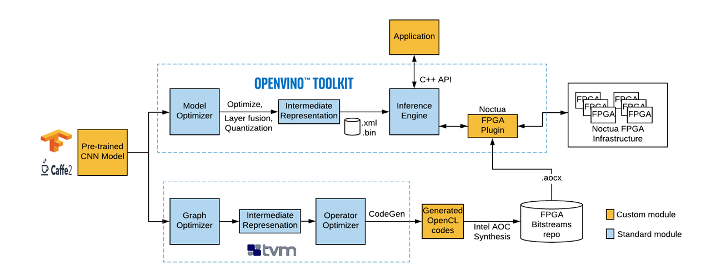
Project Workflow

Slide 5

Content / Deep learning platform & Toolkit
GoogLeNet
ResNet 50
Inception-V4
with
Intel OpenVINO FPGA Plugin
Tensor Virtual Machine

Slide 6

Tensor Virtual Machine
Frozen model
(pb)
Contains the graph definition, weights and bias of model
Neural Network Virtual Machine (NNVM):
High-level optimizations during kernel generation support different hardware backend
Various types of optimizations levels
NNVM
Kernels
Generated by TVM

Slide 7
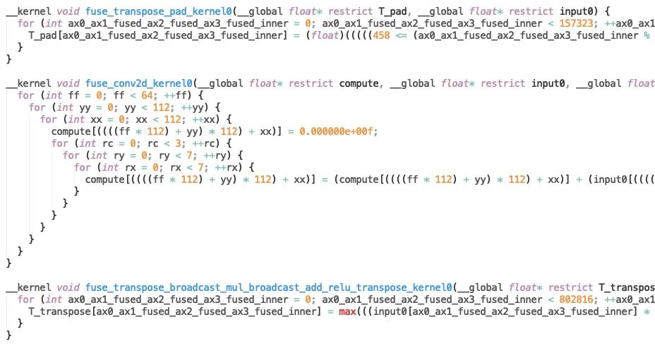
Tensor Virtual Machine - Generated kernels
Padding kernel
Convolution kernel
RELU

Slide 8
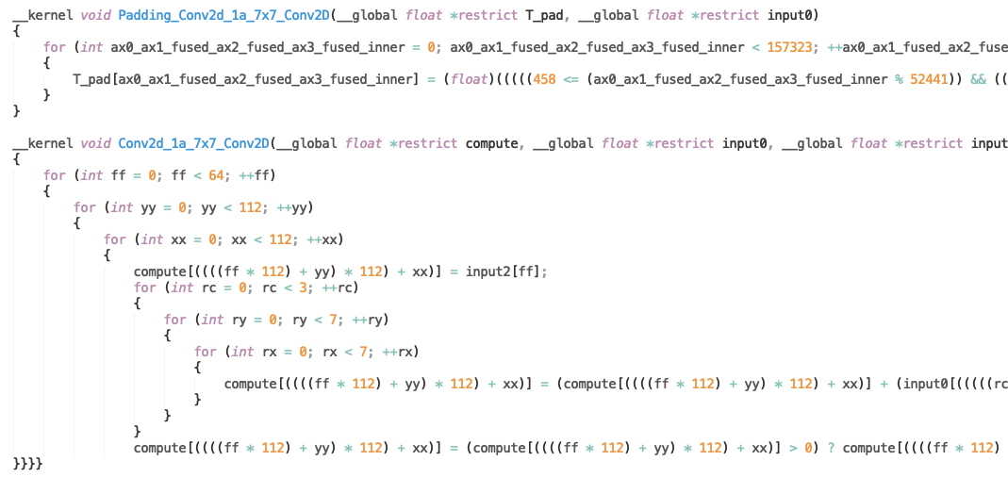
Tensor Virtual Machine - Custom kernels
Padding kernel
Convolution kernel
RELU

Slide 9
Tensor Virtual Machine
GoogLeNet:
Number of kernels generated by TVM - 116
Required number of kernels according to OpenVINO IR – 104
In case of GoogleNet, TVM generates additional transpose kernels which are handled by plugin.
ResNet:
Number of kernels generated by TVM - 75
Required number of kernels according to OpenVINO IR - 146
In case of ResNet, TVM generates only 1 kernel for all the layers which have same I/O dimensions in OpenVINO IR.

Slide 10
Challenges
IR name and kernel name mismatches
Integration with TVM issue – Different type of IR and kernel fusion techniques

Slide 11
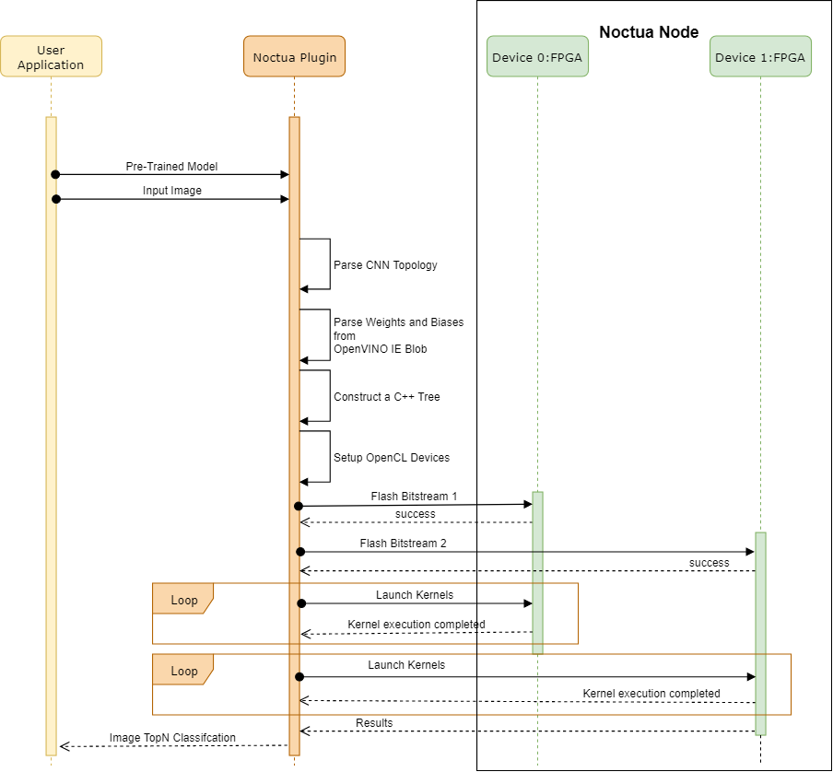
Intel OpenVINO FPGA Plugin

Slide 12
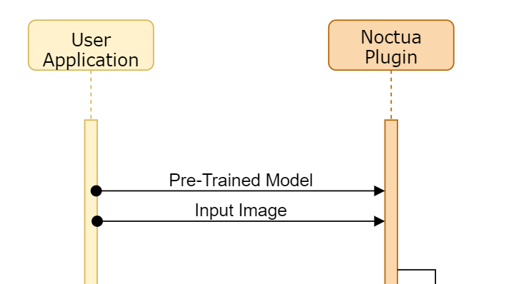
Intel OpenVINO FPGA Plugin

Slide 13
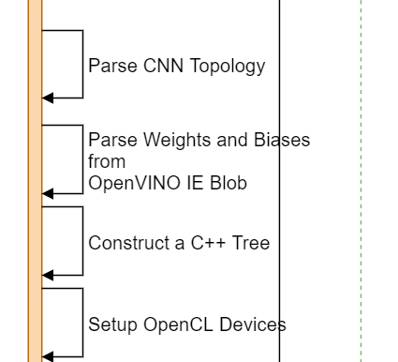
Intel OpenVINO FPGA Plugin

Slide 14
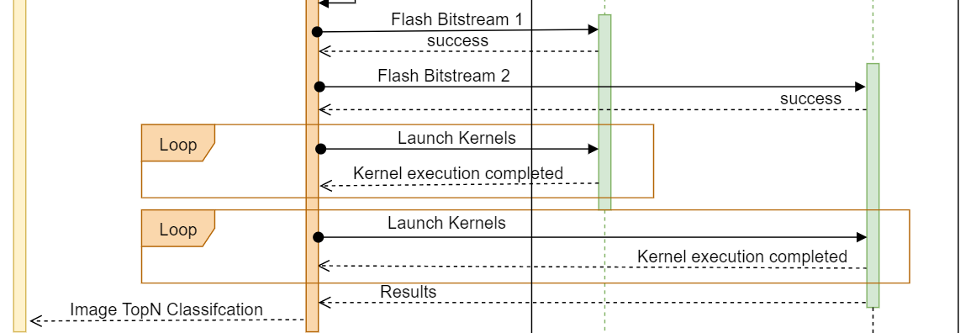
Intel OpenVINO FPGA Plugin

Slide 15
Challenges
OpenVINO FPGA plugin is not open source
Understanding the complex OpenVINO Inference Engine framework
Understanding IE Data structure (for ex: Blobs, CNNLayer, Network)
Many functions are deprecated methods in the OpenVINO codebase
OpenVINO does not support scaling
Layout mismatch between OpenVINO and TVM (NCHW and NHWC)

Slide 16
Content - Topologies
GoogLeNet
ResNet 50
Inception-V4
Baseline architecture
Optimization
Quantization
Performance model
Notes:
We have three state-of-art topologies: GoogLeNet, Resnet 50, and Inception–v4. As Anshul said we haven't started to implement the third topology yet. But for each topology, we designed baseline architecture, after that plan to apply some optimizations. Quantization is still in the research stage.
Also, for each implementation, we provide a performance model.

Slide 17
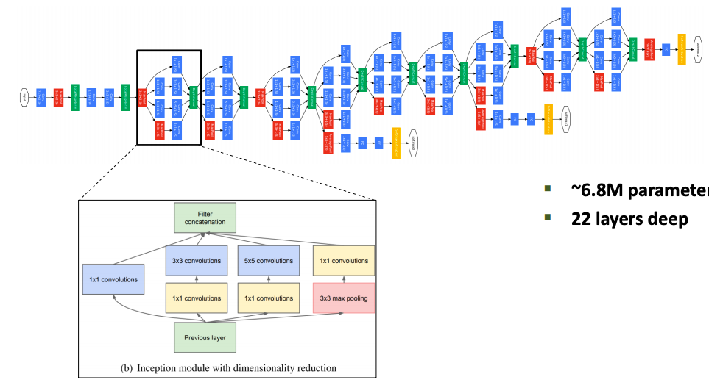
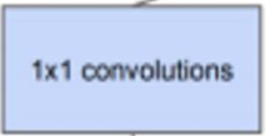
GoogLeNet (Inception-v1)
Convolution
Maxpool
Softmax
Concat
# INCEPTION MODULES: 9
# LAYERS: 22
Notes:
GoogLeNet is a deep convolution neural network and is known also like an Inception-v1. It has 22 layers considering inception module as one layer. Actually, inception module is a combination of 6 convolution layers and one max pool layer. You can see it in detail on the slide. After that we combine all outputs using concatination layer. GoogleNet has 9 inception module and all of them are the same.

Slide 18
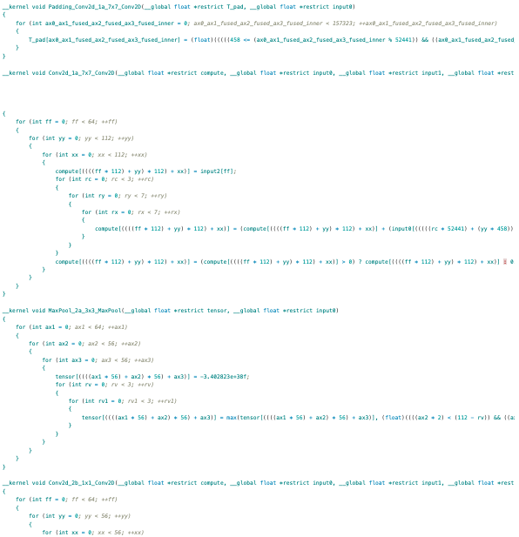
GoogLeNet - Baseline architecture
Step 1: Run one file in emulation mode for checking the correctness
Step 2: Divide all kernels on several files(.aocx) which fit FPGA
9 Files
Notes:
Firstly we generated kernels using TVM and customize them manually, fused conv kernel and relu. We launched only one file with all kernels in emulation mode and got the correct result. After that we wanted to run it on FPGAs, that's why we divided one file into 9 files which fit FPGA.

Slide 19

GoogLeNet - Baseline architecture
Convolution
Maxpool
Softmax
Concat
Each block is called an Inception Module and each block ends with concat layer
3b
(0)
3c
(1)
4b
(2)
4c
(3)
4d
(4)
4e
(5)
4f
(6)
5b
(7)
5c
(8)
Notes:
Here you see how we divided them. We called each block as Inception module and each inception module ends with concatenation layer. We also preserve the naming which was given by Openvino Intermediate representation: 3b,3c and so on.

Slide 20
GoogLeNet - Baseline architecture
Global Memory
Global memory of the system is being used for data transfer
No optimizations
Optimizations such as loop unrolling, removing data dependency, channels for
data transfer are not introduced
No Batch support
Currently the baseline model can classify only one image at a time
Notes:
Baseline architecture is using only global memory, and input parameters such as image, weights and bias store in global memory. No optimizations at all and no batch support, it means we can proceed only one image at a time.

Slide 21
GoogLeNet - Baseline architecture
Layers supported by plug-in:
Convolution
Pooling
Fully Connected
Concat
SoftMax
Reshape
Notes:
For googlenet plugin supports these layers: convolution, pooling, fully connected, concat, softmax and reshape.

Slide 22
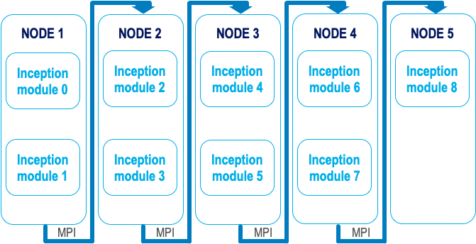
GoogLeNet - Baseline Schematic View
Notes:
Here it's a schematic view of our baseline architecture. We use 9 fpgas and for passing the results from one inception module to another we use MPI calls. For this we need 5 nodes and on the last node we launch only one fpga.

Slide 23
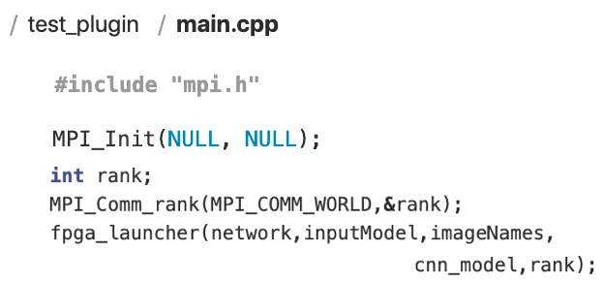
GoogLeNet - MPI within Plug-in
Notes:
This snippet shows that in our test_plugin app we use variable rank to pass it in our main function.

Slide 24
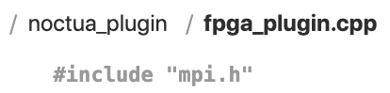
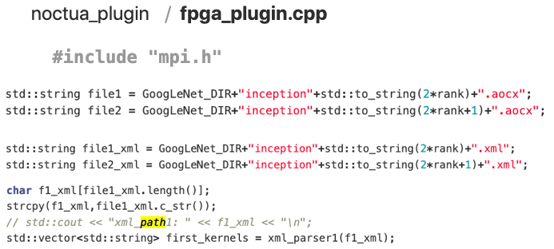
GoogLeNet - MPI within Plug-in
Notes:
Inside of our main function, we assign one aocx file to each FPGA, calculating the name of it using rank. The same for XML file. This XML file contains names of all kernels which we need to launch on this fpga.

Slide 25
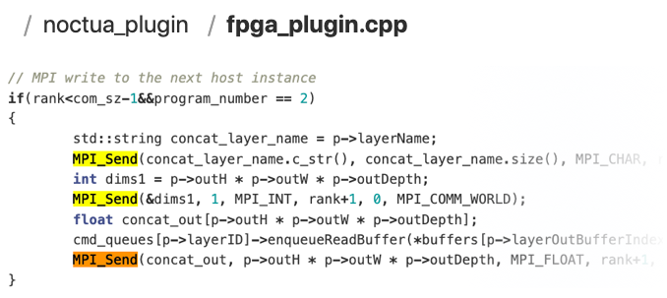
GoogLeNet - MPI within Plug-in
Notes:
This is just send calls. First we send the layer name, after dimensions and at the end the data.

Slide 26
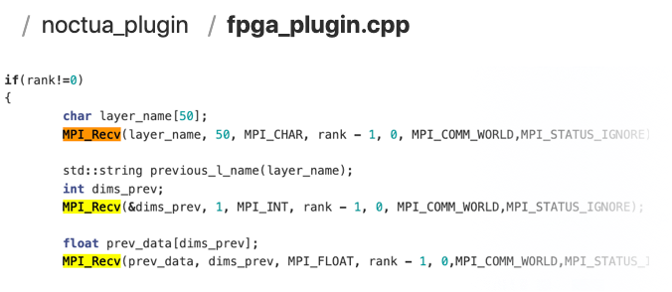
GoogLeNet - MPI within Plug-in
Notes:
This is receiving calls.

Slide 27
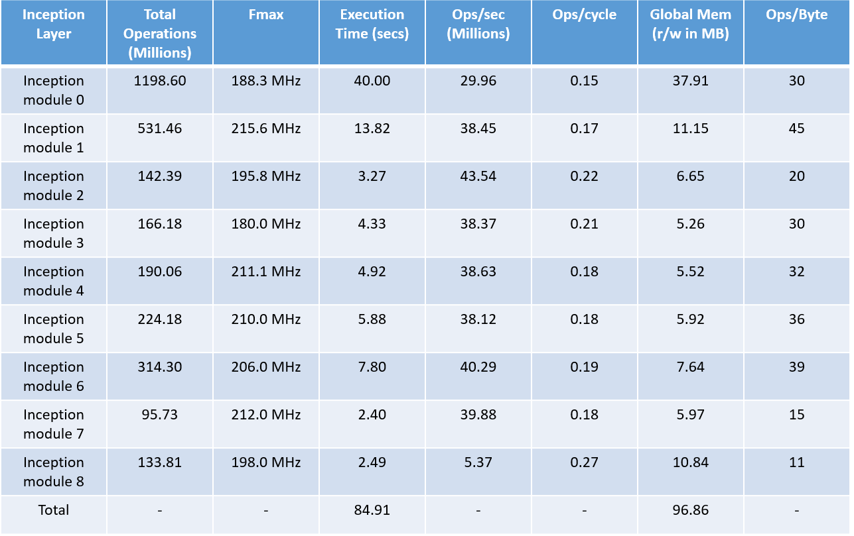
GoogLeNet Baseline - Performance Model (Measured)
Notes:
In total, our runtime is 89 seconds, which is on 3 seconds longer because we launch the plugin and use mpi calls. Inception module 0 has the longest execution time. It seems that we have a bottleneck here. Also, the strange thing that inception module 8 has a big global memory value which is related, that at the end we decrease the dimensions but out the depth increases.

Slide 28
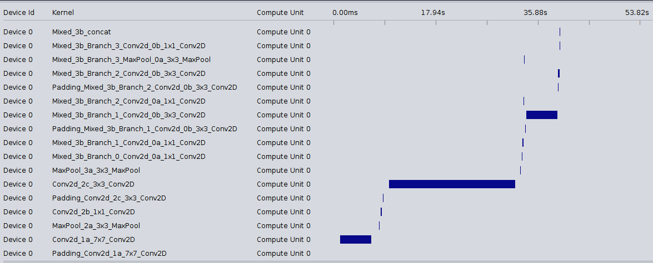
GoogLeNet Baseline - Inception0 Profiler Report
High execution time
Notes:
Here we can see the profiler for inception module0 and our convolution kernel with 3by 3 filter has a high execution time.

Slide 29
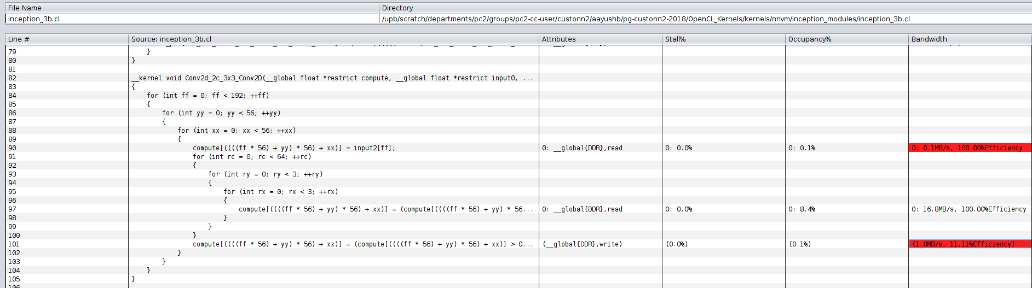
GoogLeNet Baseline - Inception0 Profiler Report
Slow data transfer speeds
Notes:
Which we can explain by underusage of maximum bandwidth of capacity.

Slide 30
GoogLeNet Baseline - Inception0 Profiler Report
Inference from profiler report:
Inefficient global memory accesses
Underusage of maximum bandwidth capacity
Next step:
Perform optimizations to reduce global memory accesses and achieve better performance For example – Using channel instead of global memory to pass the data

Slide 31
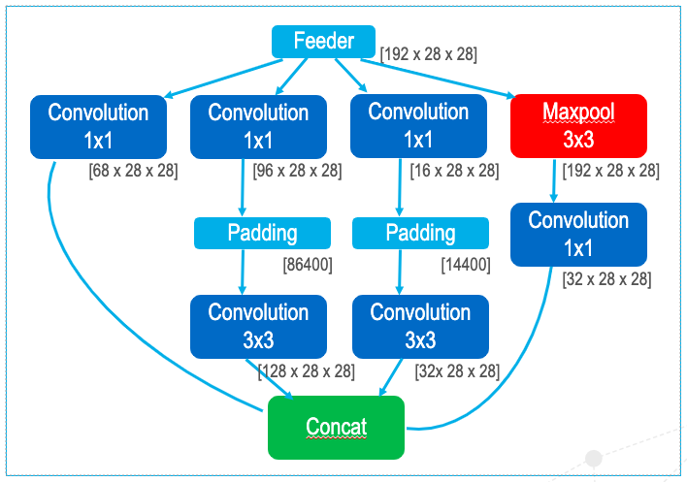
GoogLeNet - Optimization / Channels
Inception 3b
Feeder
[192 x 28 x 28]
Convolution
1x1
Convolution
1x1
Convolution
1x1
Maxpool
3x3
Inception 3a
Inception 3c
[68 x 28 x 28]
[96 x 28 x 28]
[16 x 28 x 28]
[192 x 28 x 28]
Convolution
1x1
Padding
Padding
[86400]
[14400]
[32 x 28 x 28]
Convolution
3x3
Convolution
3x3
[128 x 28 x 28]
[32x 28 x 28]
Concat
IO channels
Internal channels
Channel depth (32)

Slide 32
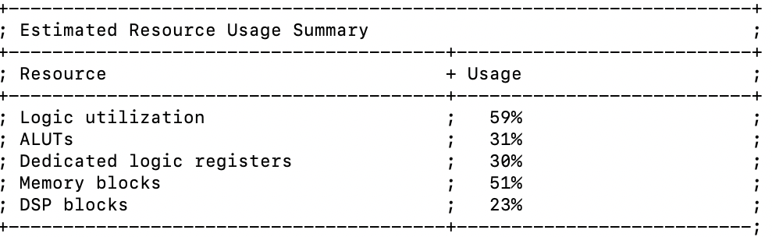

GoogLeNet - Optimization

Slide 33
GoogLeNet - Optimization
We can do better!
Apply optimizations:
Loop Unrolling
Loop Pipelining
Shift Registers
Using Local Memory

Slide 34
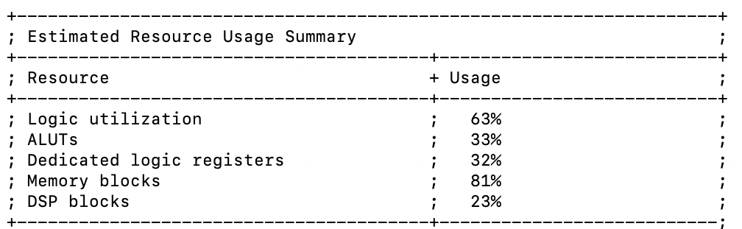
GoogLeNet - Optimization
We can do better!
Apply optimizations:
Loop Unrolling
Loop Pipelining
Shift Registers
Using Local Memory

Slide 35
GoogLeNet - Optimization
We can do better!
Apply optimizations:
Loop Unrolling
Loop Pipelining
Shift Registers
Using Local Memory

Slide 36
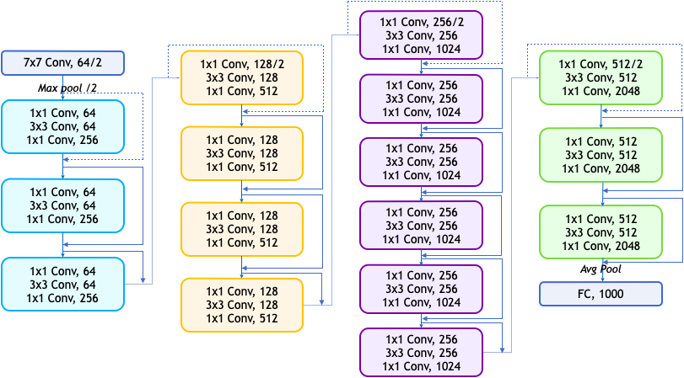
ResNet 50
# BLOCKS: 4​
# LAYERS: 50

Slide 37
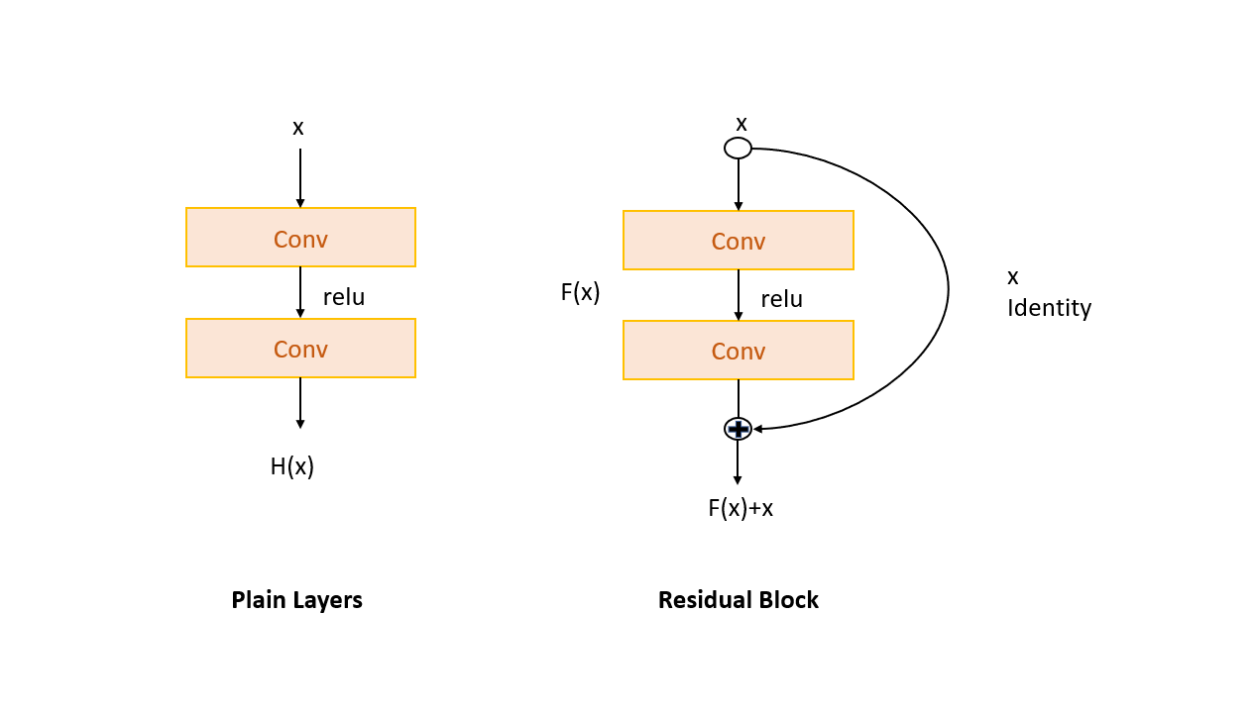
ResNet 50 - Skip connections

Slide 38
ResNet – Baseline architecture
Additional layer supported by plug-in:
Eltwise - Eltwise layer performs element-wise operation specified in parameters, over given inputs.
Scaleshift - ScaleShift layer performs linear transformation of the input blobs. Weights denote a scaling parameter, biases denote a shift

Slide 39
ResNet 50
Blocks:
0
1
2 and 3
4

Slide 40
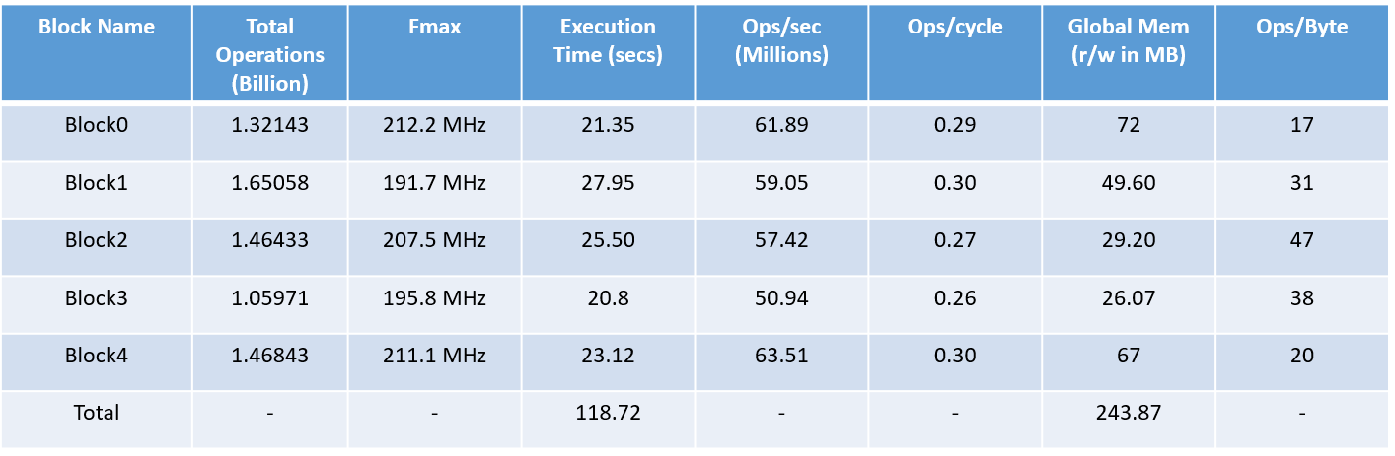
ResNet 50 – Baseline Performance Model (Measured)

Slide 41
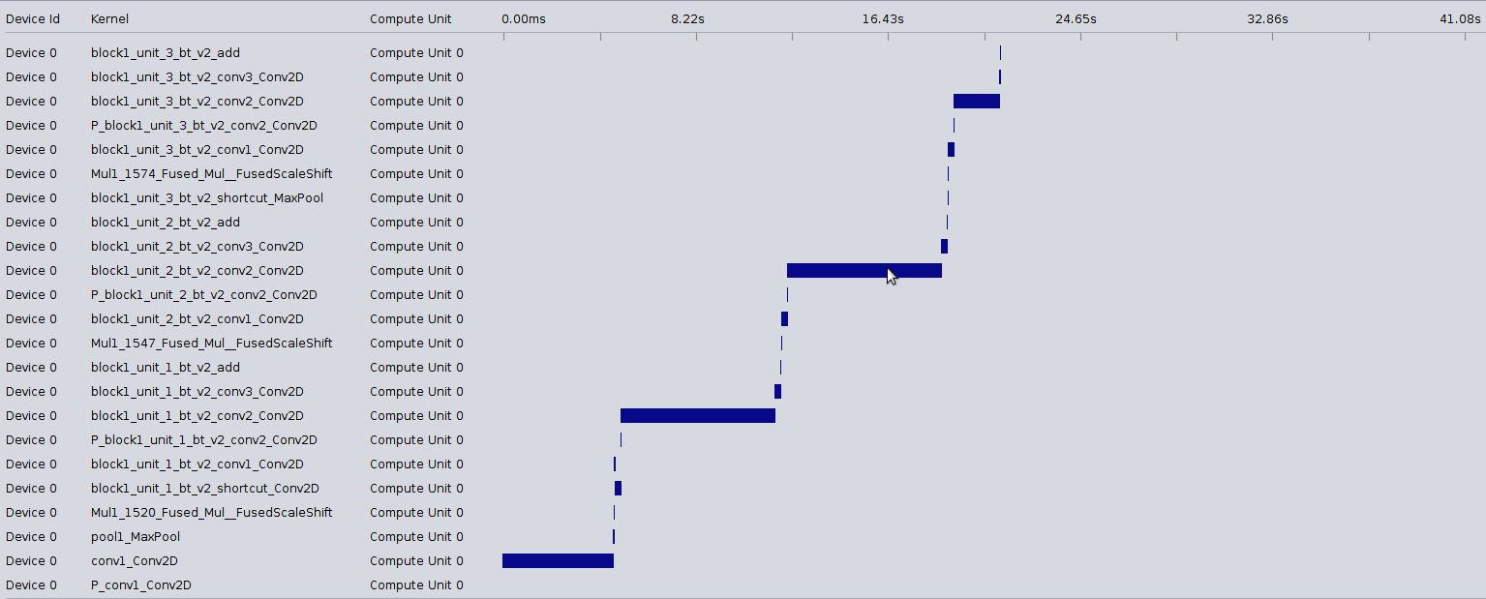
ResNet 50 – Block0 Profiler Report
High execution time

Slide 42
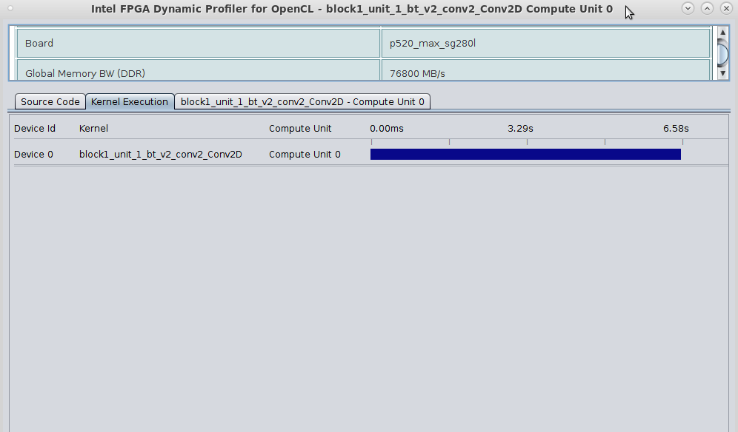
ResNet 50 – Block0 Profiler Report
All 3x3 convolution kernels in each block are bottleneck and take more time to execute Reason:
Inefficient global memory accesses

Slide 43
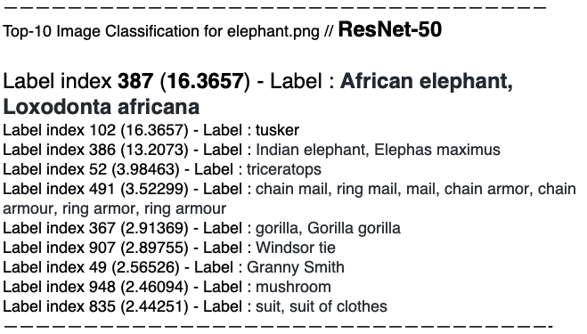
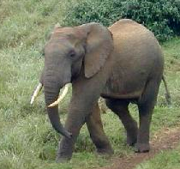
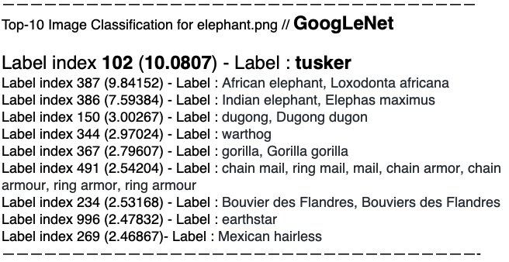
Classification Results

Slide 44
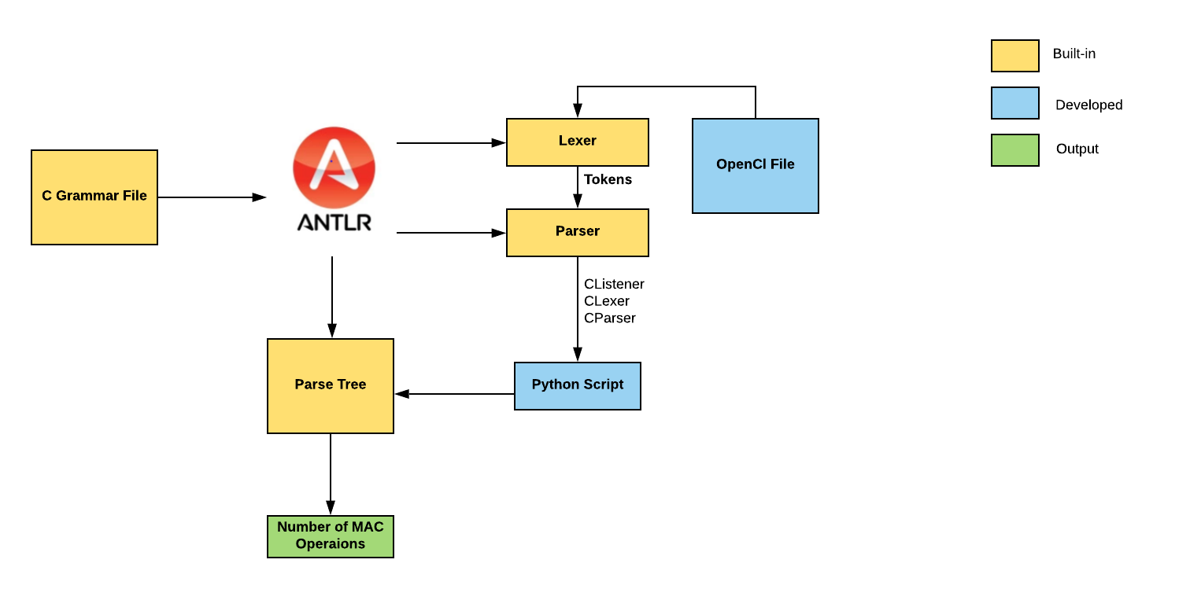
Antlr4

Slide 45
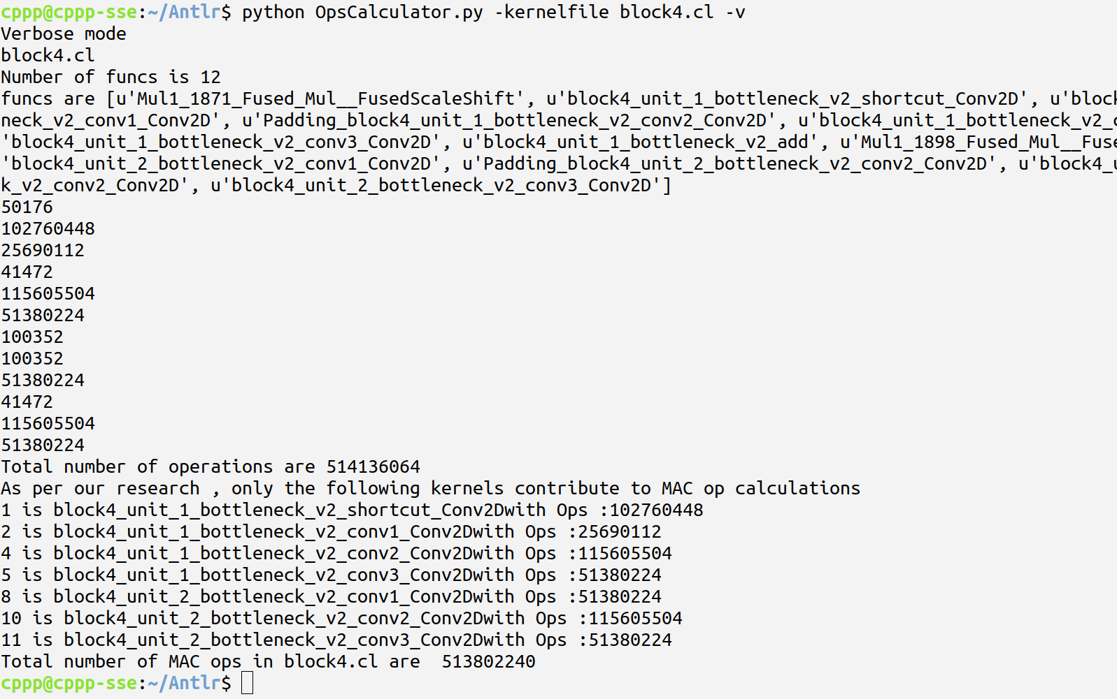
Antlr4

Slide 46
Project Organization
Code repository : GitLab
Communication channel : Slack
Meetings : 2 days in a week 3h each
Task and Issue tracking : GitLab Milestones, Issue Board and Minutes of Meeting
Project Lifecyle : Waterfall model

Slide 47
Future tasks of the Project Group
Global memory optimizations for ResNet 50
Implementation of Quantized Model for GoogleNet
Batch support for GoogleNet and ResNet 50
Implementation of Inception V4

